Slide 1
CPU SCHEDULING

Slide 2
CPU Scheduling refers to a set of policies and mechanisms build into the operating system to determine which process will be executed next.

Slide 3
Long-Term Scheduling
Determines which programs are admitted to the system for processing
Controls the degree of multiprogramming
More processes, smaller percentage of time each process is executed

Slide 4
Medium-Term Scheduling
selects which process should be removed or re-introduced into memory
Part of the swapping function
Based on the need to manage the degree of multiprogramming

Slide 5
Short-Term Scheduling
Known as the dispatcher
decision as to which available process will be executed
Executes most frequently
Invoked when an event occurs
Clock interrupts
I/O interrupts
Operating system calls

Slide 6
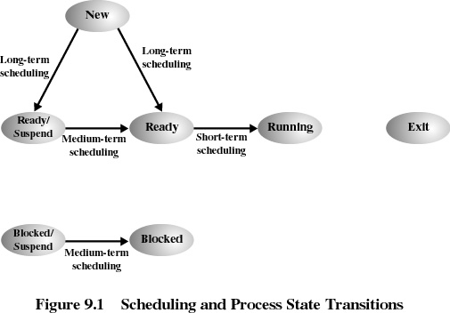

Slide 7
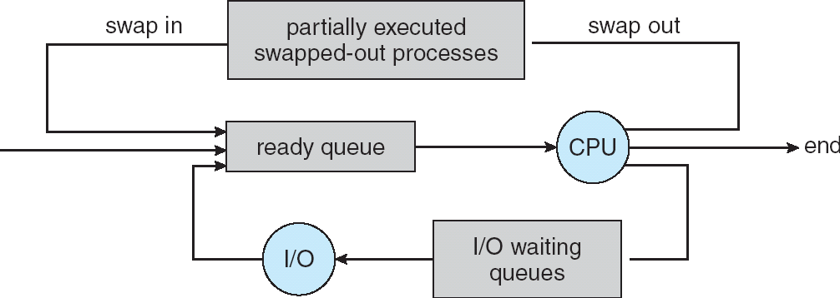

Slide 8
CPU scheduling
Determination of which process will be executed next by the CPU
The scheduler is responsible for choosing a process from the ready queue. The scheduling algorithm implemented by this module determines how process selection is done.
The scheduler hands the selected process off to the dispatcher which gives the process control of the CPU.

Slide 9
CPU and I/O Bursts
Typical process execution pattern: use the CPU for a while (CPU burst), then do some I/O operations (IO burst).
CPU bound processes perform I/O operations infrequently and tend to have long CPU bursts.
I/O bound processes spend less time doing computation and tend to have short CPU bursts.

Slide 10
CPU Scheduler
Selects from among the processes in memory that are ready to execute, and allocates the CPU to one of them
CPU scheduling decisions may take place when a process:
1. Switches from running to waiting state
2. Switches from running to ready state
3. Switches from waiting to ready
4. Terminates
Scheduling under 1 and 4 is non-preemptive
All other scheduling is preemptive

Slide 11
Preemptive & Non-preemptive Scheduling
SO what is Preemptive & Non-preemptive scheduling?
Non-preemptive
Once CPU is allocated to a process, it holds it till it
Terminates (exits)
Blocks itself to wait for I/O
Requests some OS service
Used by Windows 3.x

Slide 12
Preemptive & Non-preemptive Scheduling
Preemptive
Currently running process may be interrupted and moved to the ready state by the OS
Windows 95 introduced preemptive scheduling
Used in all subsequent versions of windows
Mac OS X uses it

Slide 13
Criteria & Objectives
CPU utilization – keep the CPU as busy as possible (40 – lightly loaded, 90 – heavily loaded)
Throughput – of processes that complete their execution per time unit
Turnaround time – amount of time to execute a particular process (total time spent on the system)
Waiting time – amount of time a process has been waiting in the ready queue
Response time – amount of time it takes from when a request was submitted until the first response is produced, not output (for time-sharing environment)

Slide 14
Optimization Criteria
Max CPU utilization
Max throughput
Min turnaround time
Min waiting time
Min response time

Slide 15
SCHEDULING ALGORITHMS
An algorithm refers to the sequence of steps followed in performing a given task
Scheduling algorithms determine the order in which processes are granted the CPU.

Slide 16
Scheduling Algorithms
FIRST-COME, FIRST SERVED:
( FCFS) same as FIFO
Procesess granted the CPU using the arrival order
Simple, fair, but poor performance. Average queueing time may be long.

Slide 17
FIFO Gantt Chart
EXAMPLE DATA:
Process Arrival Service
Time Time
1 0 8
2 1 4
3 2 9
4 3 5
FCFS
P1
P2
P3
P4
0
8
12
21
26
Average wait = ( (8-0) + (12-1) + (21-2) + (26-3) )/4 = 61/4 = 15.25
Residence Time
at the CPU

Slide 18
Priority Scheduling
Algorithm that gives preferential treatment to important
jobs
Each process is associated with a priority and the one with the
highest priority is granted the CPU
Equal priority processes are scheduled in FCFS order
Priorities can be assigned to processes by a system
administrator (e.g. staff processes have higher priority
than student ones) or determined by the Processor
Manager on characteristics such as:
– Memory requirements
– Peripheral devices required
– Total CPU time
– Amount of time already spent processing

Slide 19
Scheduling Algorithms
Shortest Job First (SJF)
Special case of priority scheduling (priority = expected length of CPU burst)
Non-preemptive version: scheduler chooses the process with the least amount of work to do (shortest CPU burst).

Slide 20
Scheduling Algorithms
Shortest Job First (SJF)
SJF pros & cons:
Better average response time.
It’s the best you can do to minimize average response time-- can prove the algorithm is optimal.
Difficult to predict the future.
Unfair-- possible starvation (many short jobs can keep long jobs from making any progress).

Slide 21
Example of Non-Preemptive SJF
Process Arrival Time Burst Time
P₁ 0.0 7
P₂ 2.0 4
P₃ 4.0 1
P₄ 5.0 4
SJF (non-preemptive)
P₁
P₃
P₂
P₄
0
3
7
8
12
16
Average waiting time = (0 + 6 + 3 + 7)/4 = 4

Slide 22
Problems with SJF
Impossible to predict CPU burst times
Schemes based on previous history (e.g. exponential averaging)
SJF may lead to starvation of long jobs
Solution to starvation- Age processes: increase priority as a function of waiting time

Slide 23
Shortest Remaining Time First(next)
Preemptive version of the SJF algorithm
CPU is allocated to the job that has the shortest CPU burst.
Can be preempted if there is a newer job in the ready queue that is shorter than the one currently running

Slide 24
Round robin (RR)
Often used for timesharing
Ready queue is treated as a circular queue (FIFO)
Each process is given a time slice called a quantum (q)
– It is run for the quantum or until it finishes
– RR allocates the CPU uniformly (fairly) across all participants.
Definitions:
Context Switch Changing the processor from running one task (or process) to another. Implies changing memory.
Processor Sharing Use of a small quantum such that each process runs frequently at speed 1/n.
Reschedule latency How long it takes from when a process requests to run, until it finally gets control of the CPU.

Slide 25
RR Gantt Chart
EXAMPLE DATA:
Process Arrival Service
Time Time
1 0 8
2 1 4
3 2 9
4 3 5
Note:
Example violates rules for quantum size since most processes don’t finish in one quantum.
Round Robin, quantum = 4, no priority-based preemption
P1
P2
P3
P4
P1
P3
P4
P3
0
4
8
12
16
20
24
25
26
Average wait = ( (20-0) + (8-1) + (26-2) + (25-3) )/4 = 74/4 = 18.5

Slide 26
RR Summary
Pros and Cons:
Better for short jobs (+)
Fair (+)
Context-switching time adds up for long jobs (-)
The previous examples assumed no additional time was needed for context switching – in reality, this would add to wait and completion time without actually progressing a process towards completion.
Remember: the OS consumes resources, too!
If the chosen quantum is
too large, response time suffers
infinite, performance is the same as FIFO
too small, throughput suffers and percentage overhead grows
Actual choices of timeslice:
UNIX: initially 1 second:
Worked when only 1-2 users
If there were 3 compilations going on, it took 3 seconds to echo each keystroke!
In practice, need to balance short-job performance and long-job throughput:
Typical timeslice 10ms-100ms
Typical context-switch overhead 0.1ms – 1ms (about 1%)

Slide 27
Multi-level Feedback Scheduling
Another method for exploiting past behavior
Multiple queues, each with different priority
Higher priority queues often considered “foreground” tasks
Each queue has its own scheduling algorithm
E.g. foreground → RR, background → FCFS
Sometimes multiple RR priorities with quantum increasing exponentially (highest queue: 1ms, next: 2ms, next: 4ms, etc.)
Adjust each job’s priority as follows (details vary)
Job starts in highest priority queue
If entire CPU time quantum expires, drop one level
If CPU is yielded during the quantum, push up one level (or to top)

Slide 28
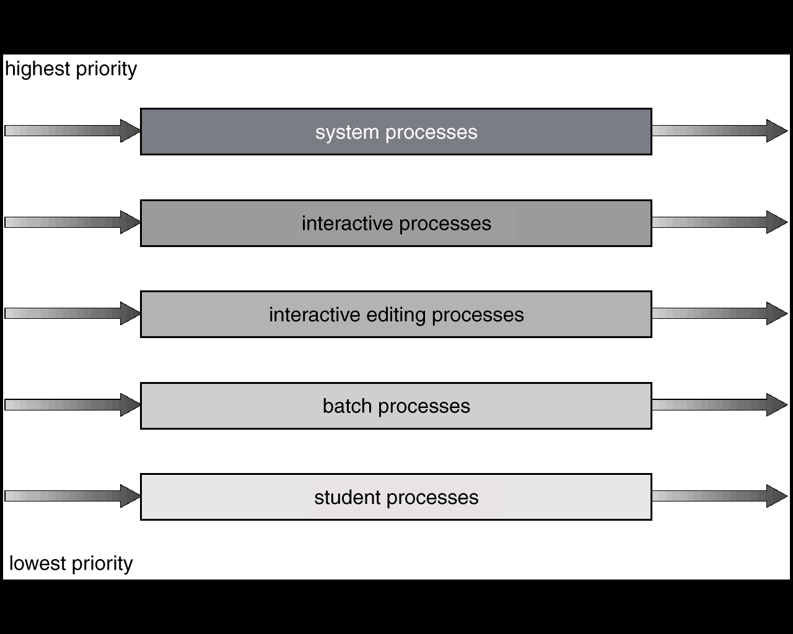
MULTI-LEVEL QUEUES:
Each queue has its scheduling algorithm.
Then some other algorithm (perhaps priority based) arbitrates between queues.
Can use feedback to move between queues
Method is complex but flexible.
For example, could separate system processes, interactive, batch, favored, unfavored processes

Slide 29
FCFS scheduling, FIFO Run Until Done:
Simple, but short jobs get stuck behind long ones
RR scheduling:
Give each thread a small amount of CPU time when it executes, and cycle between all ready threads
Better for short jobs, but poor when jobs are the same length
SJF/SRTF:
Run whatever job has the least amount of computation to do / least amount of remaining computation to do
Optimal (average response time), but unfair; hard to predict the future
Multi-Level Feedback Scheduling:
Multiple queues of different priorities
Automatic promotion/demotion of process priority to approximate SJF/SRTF
Priority Scheduling:

